Slide 1
Probability Distribution
Rajat Srivastava

Slide 2
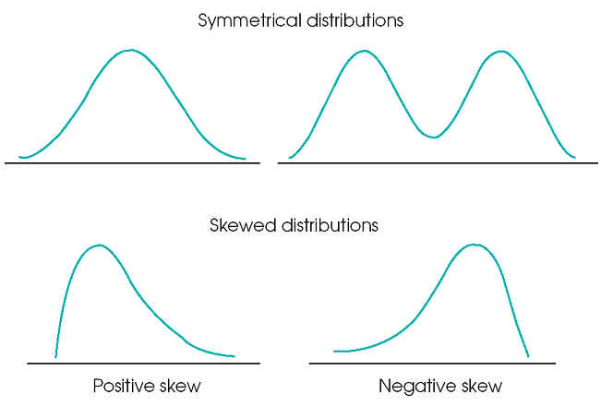
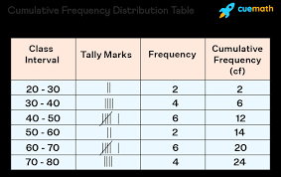
Frequency Distribution
The frequency (f) of a particular value is the number of times the value occurs in the data. The distribution of a variable is the pattern of frequencies, meaning the set of all possible values and the frequencies associated with these values. Frequency distributions are portrayed as frequency tables or charts.
What are the advantages of frequency distribution?
The advantage of using frequency distributions is that they present raw data in an organized, easy-to-read format. The most frequently occurring scores are easily identified, as are score ranges, lower and upper limits, cases that are not common, outliers, and total number of observations between any given scores.
Real Life Applications of Frequency Distribution
Frequency distribution is used to organize the collected data in table form. The data could be marks scored by students, temperatures of different towns, points scored in a volleyball match, etc.

Slide 3
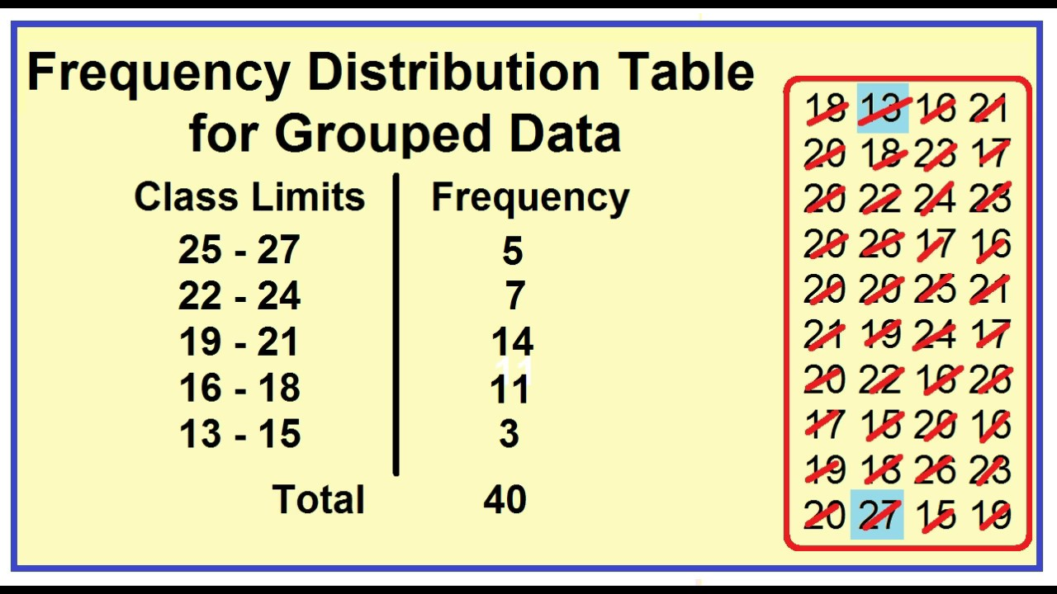
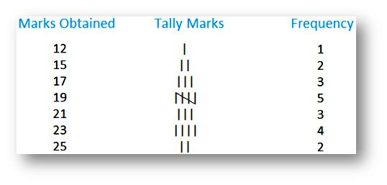
Types of Frequency Distribution
There are four types of frequency distribution under statistics which are explained below:
Ungrouped frequency distribution: It shows the frequency of an item in each separate data value rather than groups of data values.
Grouped frequency distribution: In this type, the data is arranged and separated into groups called class intervals. The frequency of data belonging to each class interval is noted in a frequency distribution table. The grouped frequency table shows the distribution of frequencies in class intervals.

Slide 4
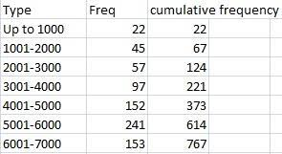
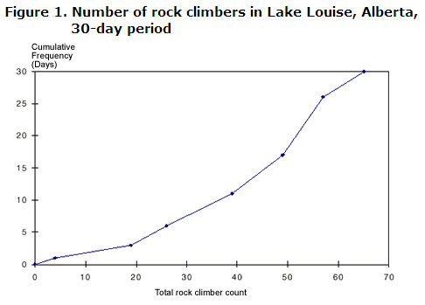
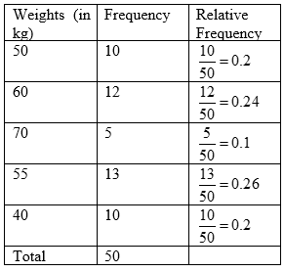
Cumulative Frequency Distribution
Relative Frequency Distribution
A related distribution is known as a relative frequency distribution, which shows the relative frequency of each value in a dataset as a percentage of all frequencies.

Slide 5
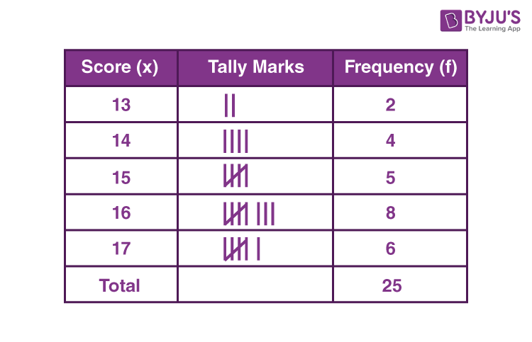
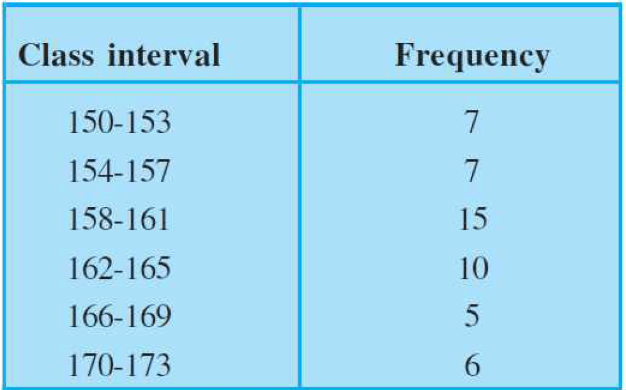
Types of Frequency Distribution
Discrete Frequency Distribution( Ungrouped ) (Grouped )Continuous Frequency Distribution
The number of times each value occurs denotes the frequencies of the specific value or observation. Discrete frequency distribution is also known as ungrouped frequency distribution.
A continuous frequency distribution is a series in which the data are classified into different class intervals without gaps and their respective frequencies are assigned as per the class intervals and class width.

Slide 6

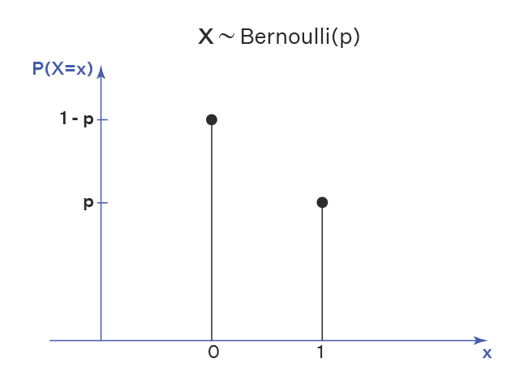
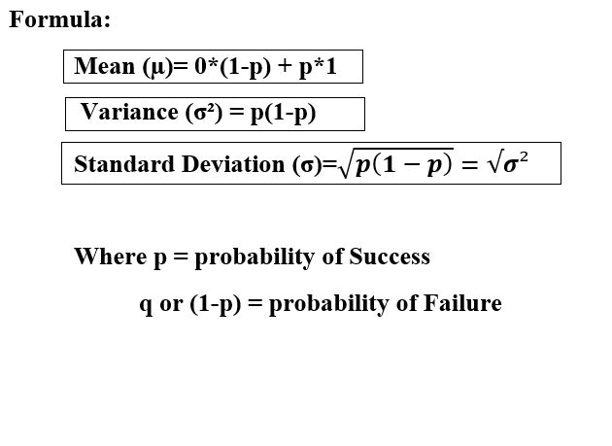
Bernoulli distribution
Bernoulli distribution applies to events that have one trial and two possible outcomes. These are known as Bernoulli trials.
Will this coin land on heads when I flip it?
Will I roll a six with this die?
Will I pick an ace from this deck of cards?
Will voter X vote “yes” in a political referendum?
Will student Y pass their math test?
In Bernoulli trials, the two possible outcomes can be thought of in terms of “success” or “failure”—but these labels are not to be taken literally. In this context, “success” simply means getting a “yes” outcome (for example, rolling a six, picking an ace, and so on).

Slide 7
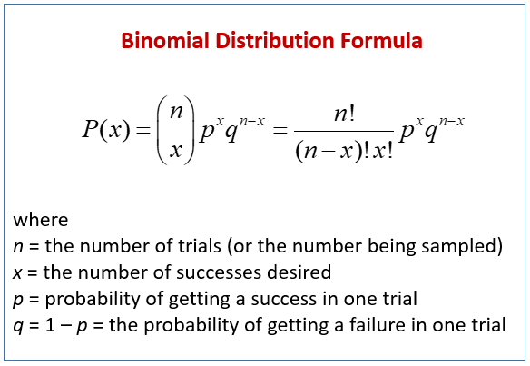
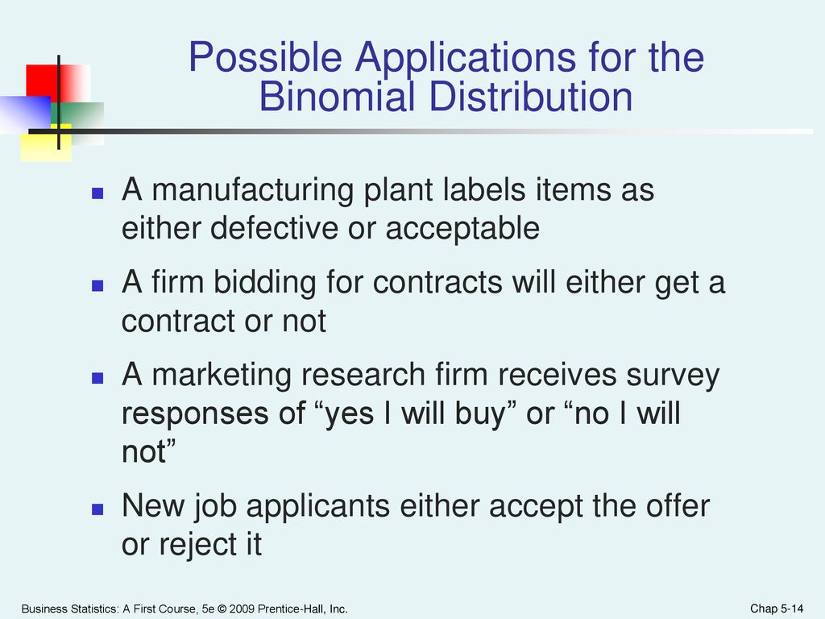
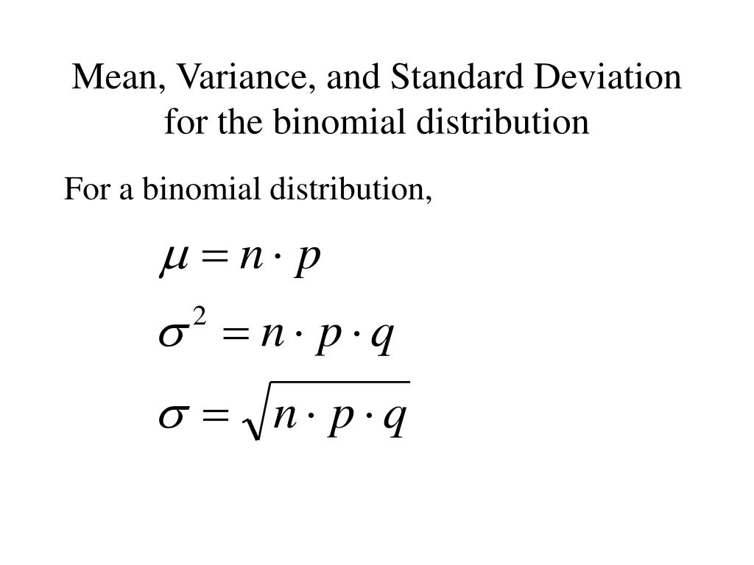
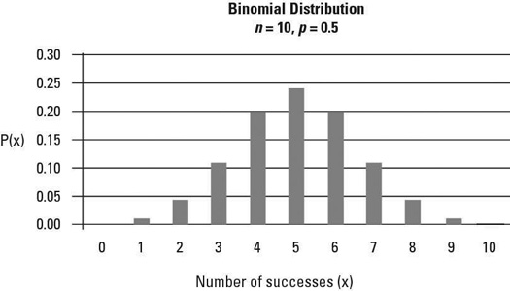
Binomial distribution
The Bernoulli distribution represents the success or failure of a single Bernoulli trial.
Vs
The Binomial Distribution represents the number of successes and failures in n independent Bernoulli trials for some given value of n

Slide 8
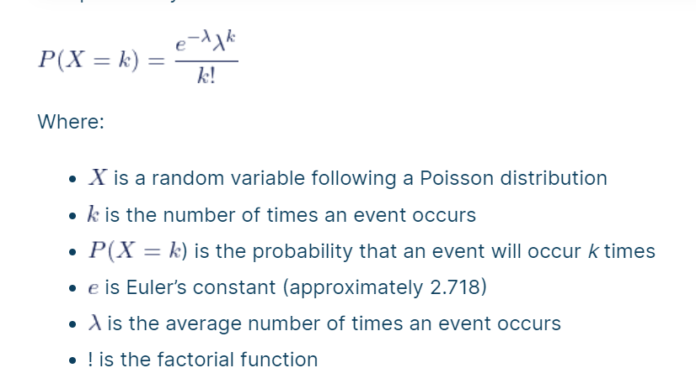
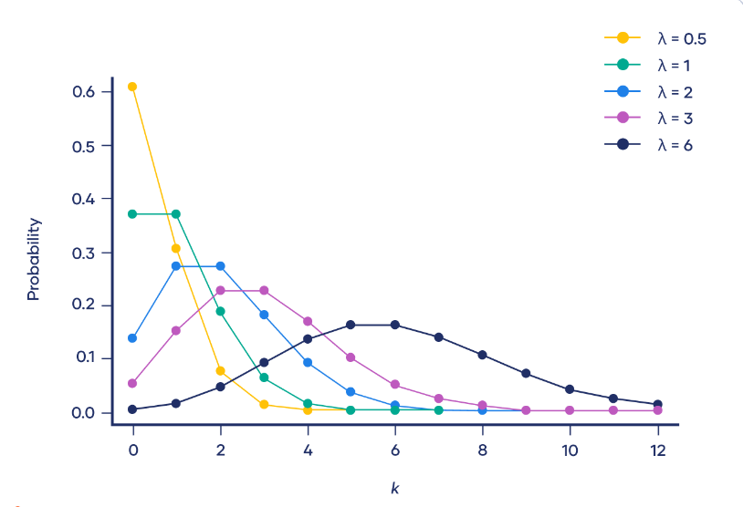
Poisson Distribution
The Poisson distribution is used to model the number of events occurring within a given time interval.
Example:
the number of cars passing through the intersection of Allen Street and College Avenue in one minute.
number of customers at an ATM in 10-minute intervals.
the number of students arriving during office hours.
Text messages per hour
Male grizzly bears per hectare
Machine malfunctions per year
Website visitors per month
Influenza cases per year

Slide 9
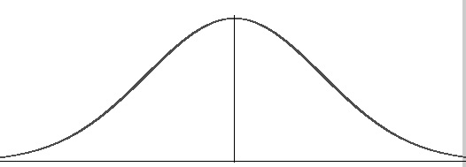
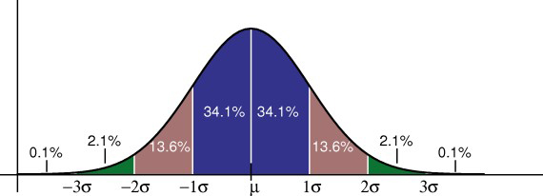
Normal Distribution
For example, the bell curve is seen in tests like the SAT and GRE. The bulk of students will score the average (C), while smaller numbers of students will score a B or D. An even smaller percentage of students score an F or an A
Why do normal distributions matter?
1) All kinds of variables in natural and social sciences are normally or approximately normally distributed. Height, birth weight, reading ability, job satisfaction, or SAT scores are just a few examples of such variables.
2) Because normally distributed variables are so common, many statistical tests are designed for normally distributed populations.
3) Understanding the properties of normal distributions means you can use inferential statistics to compare different groups and make estimates about populations using samples

Slide 10
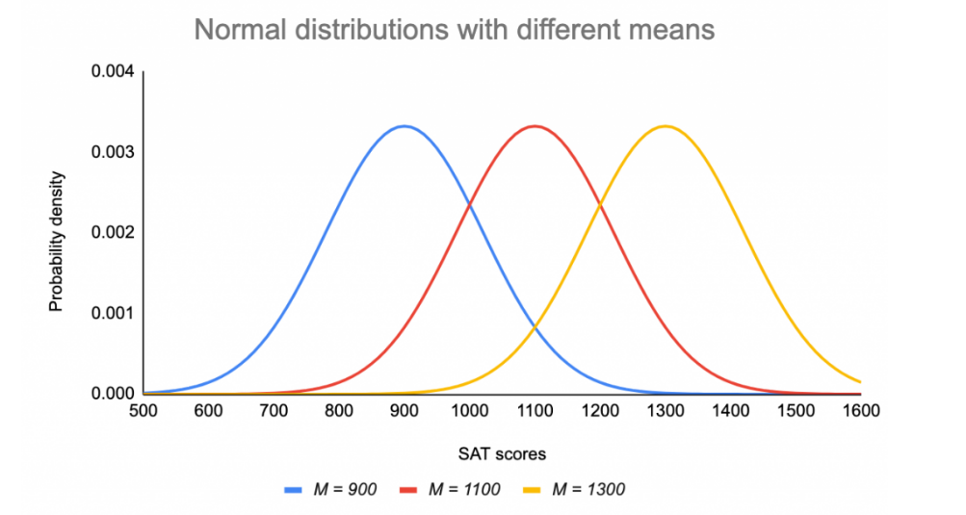
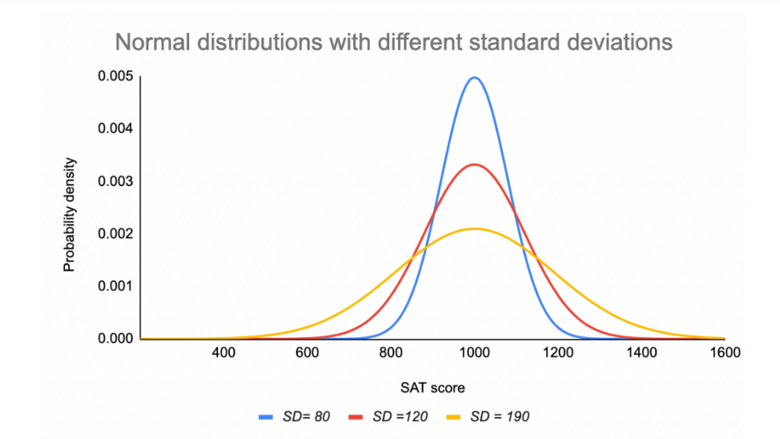
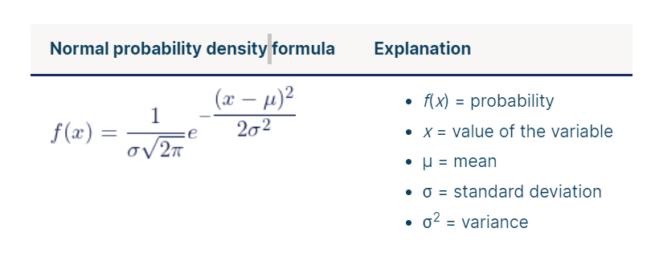
Q1. You collect SAT scores from students in a new test preparation course. The data follows a normal distribution with a mean score (M) of 1150 and a standard deviation (SD) of 150.

Slide 11
Standard Normal Distribution and Standard Scores
The standard normal distribution is a special case of the normal distribution where the mean is zero and the standard deviation is 1. This distribution is also known as the Z-distribution.
A value on the standard normal distribution is known as a standard score or a Z-score. A standard score represents the number of standard deviations above or below the mean that a specific observation falls.
For example, a standard score of 1.5 indicates that the observation is 1.5 standard deviations above the mean. On the other hand, a negative score represents a value below the average. The mean has a Z-score of 0.
Some statistical hypothesis tests assume that the data follow a bell curve.
Linear and nonlinear regression both assume that the residuals follow a Gaussian distribution .
The central limit theorem states that as the sample size increases, the sampling distribution of the mean follows a normal distribution even when the underlying distribution of the original variable is non-normal.

Slide 12
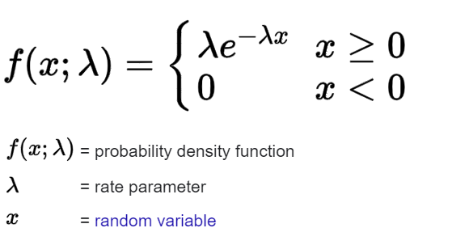
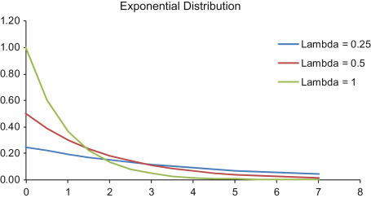
Exponential Distribution
The exponential distribution is often concerned with the amount of time until some specific event occurs.
The amount of time (beginning now) until an earthquake occurs has an exponential distribution.
The length, in minutes, of long-distance business telephone calls
The amount of time, in months, a car battery lasts.
The value of the change that you have in your pocket or purse follows approximately exponential distribution.
The amount of money customers spend in one trip to the supermarket because There are fewer large values and more small values . There are more people who spend small amounts of money and fewer people who spend large amounts of money.
The exponential distribution is widely used in the field of reliability. Reliability deals with the amount of time a product lasts.
mean 1/λ
variance 1/λ².

Slide 13

Relationship Between The Poisson And The Exponential Distribution
Suppose that the time that elapses between two successive events follows the exponential distribution with a mean of μ units of time. Also assume that these times are independent, meaning that the time between events is not affected by the times between previous events. If these assumptions hold, then the number of events per unit time follows a Poisson distribution with mean λ = 1/μ
For example, the number of times the telephone rings per hour. By contrast, the time between occurrences follows the exponential distribution. For example. The telephone just rang, how long will it be until it rings again? We are measuring length of time of the interval, a continuous random variable, exponential, not events during an interval, Poisson.

Slide 14
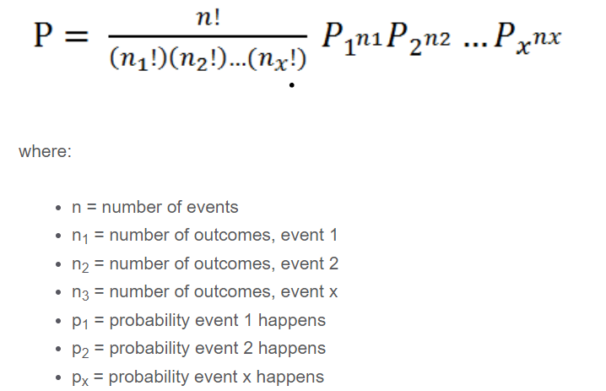
Multinomial Distribution (Generalization Of Binomial Distribution
in finance to estimate the probability of a given set of outcomes occurring, such as the likelihood a company will report better-than-expected earnings while its competitors report disappointing earnings.
The multinomial distribution applies to experiments in which the following conditions are true:
The experiment consists of repeated trials, such as rolling a die five times instead of just once.
Each trial must be independent of the others. For example, if you roll two dice, the outcome of one die does not impact the outcome of the other die.
The probability of each outcome must be the same across each instance of the experiment. For example, if a fair, six-sided die is used, then there must be a one in six chance of each number being given on each roll.
Each trial must produce a specific outcome, such as a number between two and 12 if rolling two six-sided dice.

Slide 15
Real-World Example of the Multinomial Distribution
In investing, a portfolio manager or financial analyst might use the multinomial distribution to estimate the probability of (a) a small-cap index outperforming a large-cap index 70% of the time, (b) the large-cap index outperforming the small-cap index 25% of the time, and (c) the indexes having the same (or approximate) return 5% of the time.
In this scenario, the trial might take place over a full year of trading days, using data from the market to gauge the results. If the probability of this set of outcomes is sufficiently high, the investor might be tempted to make an overweight investment in the small-cap index.

Slide 16
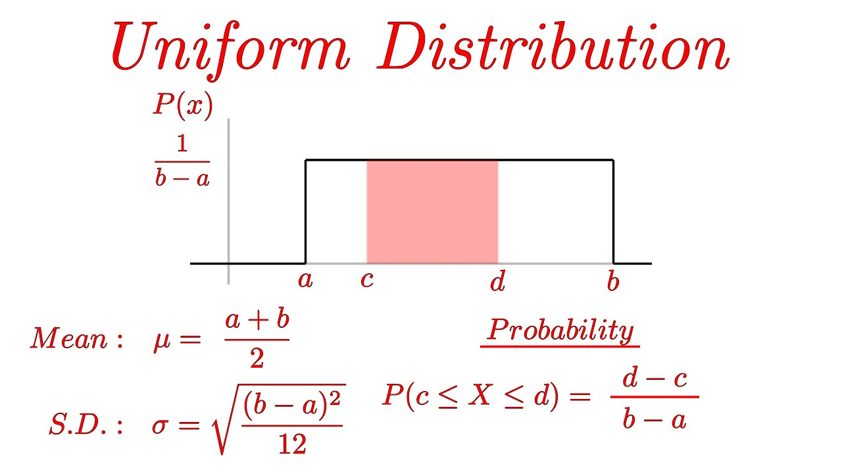
Continuous Uniform Distribution
Multinomial Distribution (Generalization Of Binomial Distribution
A type of continuous probability distribution in which all outcomes are equally likely. A deck of cards has within it uniform distributions because the likelihood of drawing a heart, a club, a diamond, or a spade is equally likely.

Slide 17
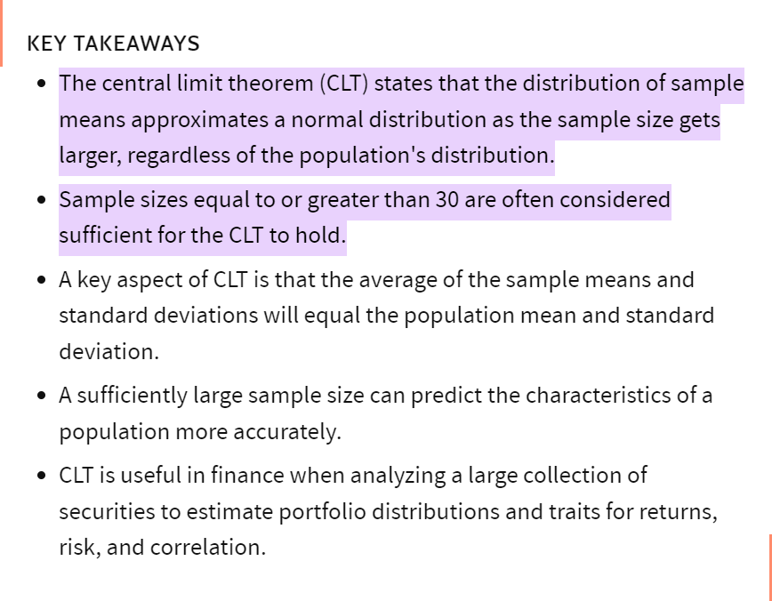
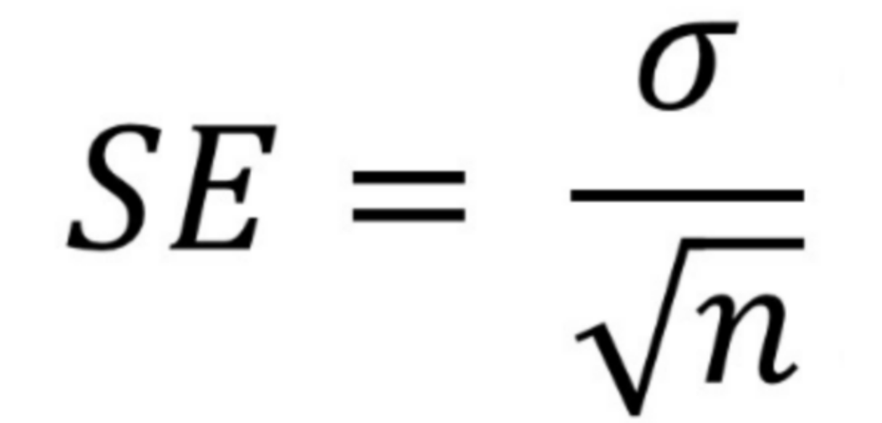
Central Limit Theorem

Slide 18
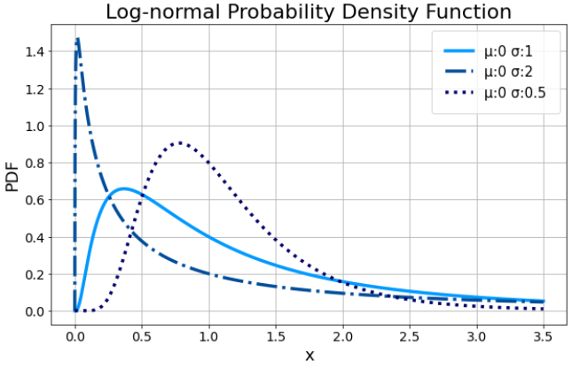
Log Normal Distribution
In general, most log-normal distributions are the result of taking the natural log where the base is equal to e=2.718. However, the log-normal distribution can be scaled using a different base which affects the shape of the lognormal distribution.
Mainly, normal distributions can allow for negative random variables while log-normal distributions include all positive variables.
One of the most common applications where log-normal distributions are used in finance is in the analysis of stock prices. The potential returns of a stock can be graphed in a normal distribution. The prices of the stock, however, can be graphed in a log-normal distribution. The log-normal distribution curve can therefore be used to help better identify the compound return that the stock can expect to achieve over a period of time.

Slide 19
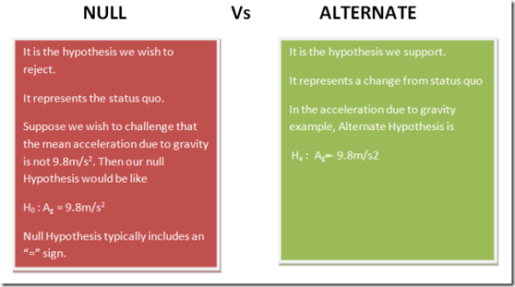
Test of Hypothesis

Slide 20
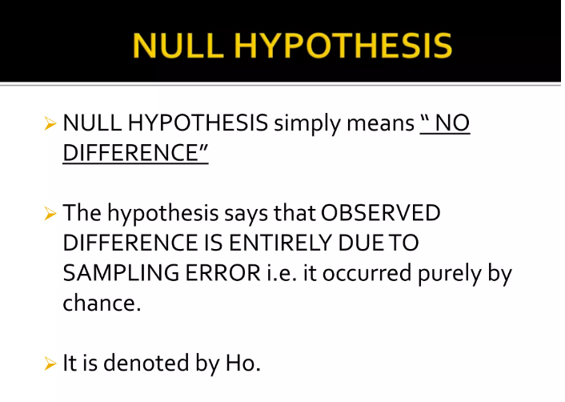
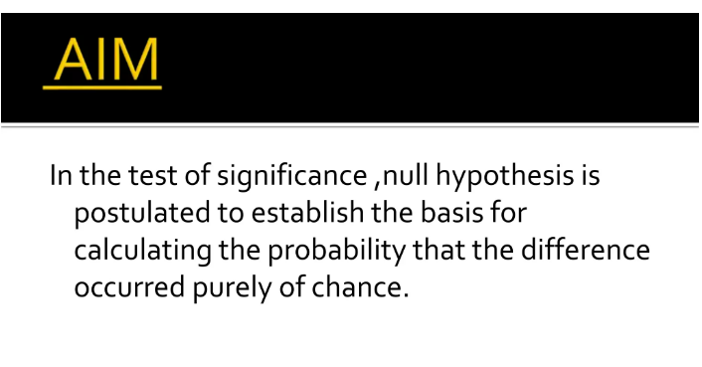

Slide 21
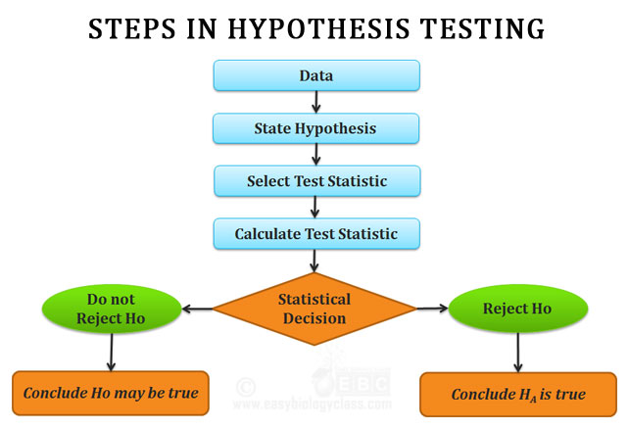

Slide 22
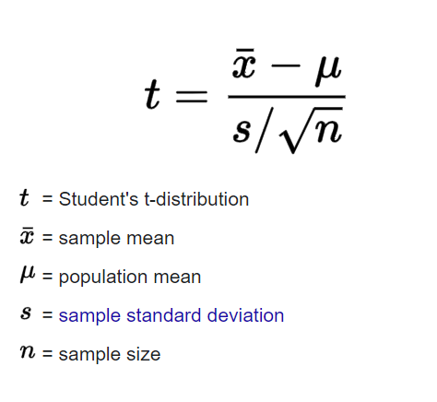
Student T distribution
Student’s t-distribution or t-distribution is a probability distribution that is used to calculate population parameters when the sample size is small and when the population variance is unknown. Theoretical work on t-distribution was done by W.S. Gosset; he has published his findings under the pen name “Student“. That’s why it is called as Student’s t-test.
It is the sampling distribution of the t-statistic. The values of the t-statistic is given by:

